Slide 1
Options

Slide 2
Agenda
Brain teasers/coding
Options

Slide 3
Brain Teaser 1
There is a regular die and a special invisible die. You know that regular die has integers 1 to 6, but don't know what's on the invisible dice. After tossing, I speak the sum of outcome of both die. It so happens that the outcome is an integer between 1 to 12, with equal probability (1/12 each). Can you guess what are the numbers printed on special invisible dice?

Slide 4
Brain Teaser 2
In a dark room, there is a deck of 52 cards, with exactly 10 cards facing up, rest facing down. You need to split this into two decks with equal number of cards facing up!

Slide 5
Working Through a Coding Question

Slide 6
What are Options?
An option is a contract giving the buyer the right—but not the obligation—to buy (call) or sell (put) the underlying asset at a specific price on or before a certain date.

Slide 7
What is a Strike Price
This price is known as the option's strike price (or exercise price). For call options, the strike price is where the security can be bought by the option holder; for put options, the strike price is the price at which the security can be sold.

Slide 8
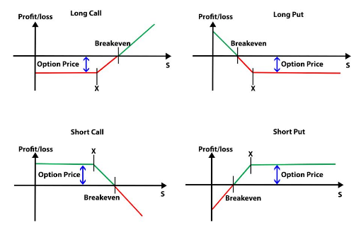
Types of Options

Slide 9
In the Money vs Out of the Money
Calls with strikes that are higher than the market, or puts with strikes lower than the market, are instead out-of-the-money (OTM), and only have extrinsic value (also known as time value).

Slide 10
Why are Options Needed
Options can be less risky for investors because they require less financial commitment than equities,
they can also be less risky due to their relative imperviousness to the potentially catastrophic effects of gap openings.
Options are the most dependable form of hedge, and this also makes them safer than stocks.

Slide 11
Example
I buy a call on Apple to buy 10 shares at 185 next week for $20. Apple currently at $182.36

Slide 12
How would you price this
Let’s say we roll a dice and you have a call at the EV of 3.5
What is a fair price for this option?
What about if we roll a dice 2 times and its sum with a call at 7.0

Slide 13
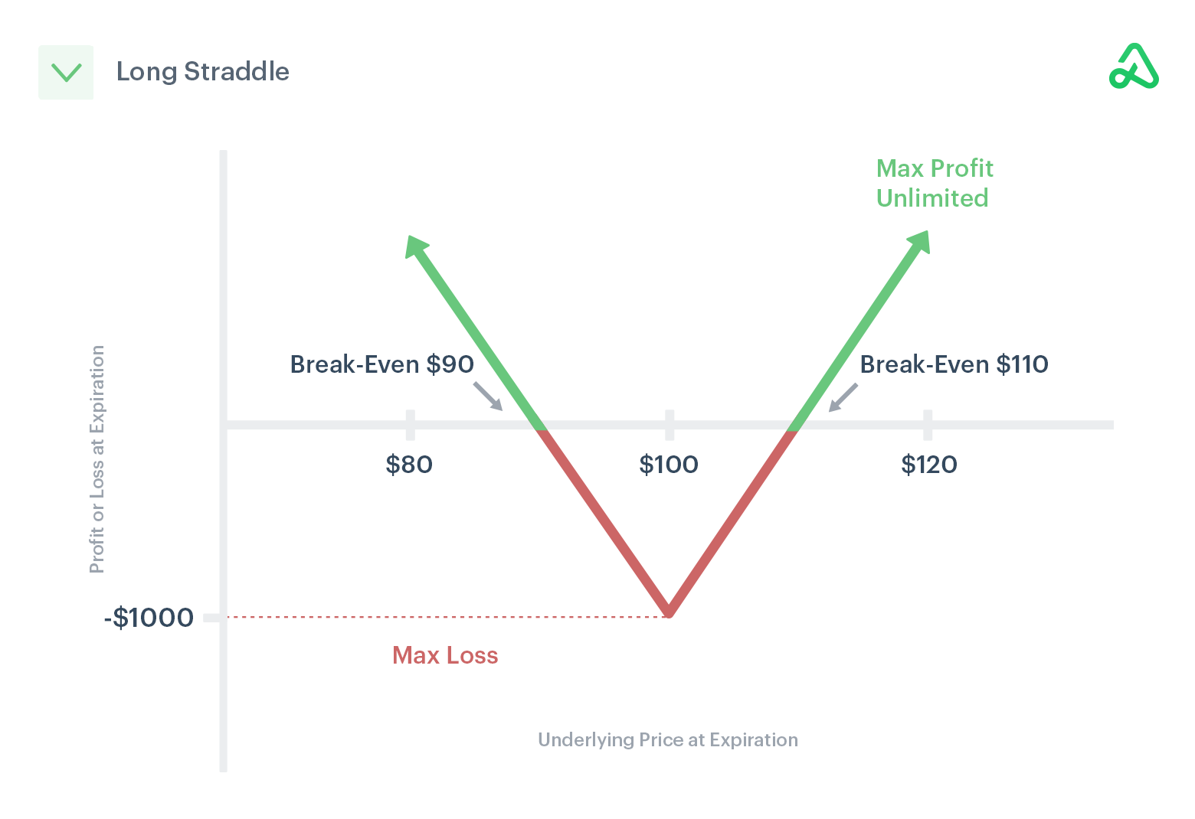
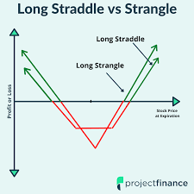
Combined

Slide 14
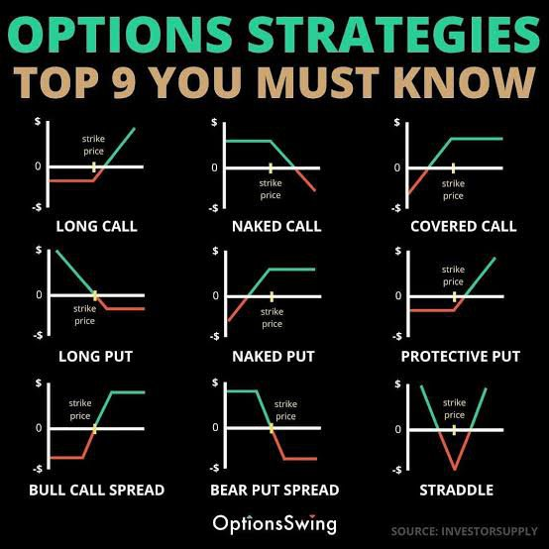
More Combined Options

